Slide 1


Si Online Technomart private limited
Domestic Money Transfer
Domestic money transfer ‘’fact sheet’’

Slide 2
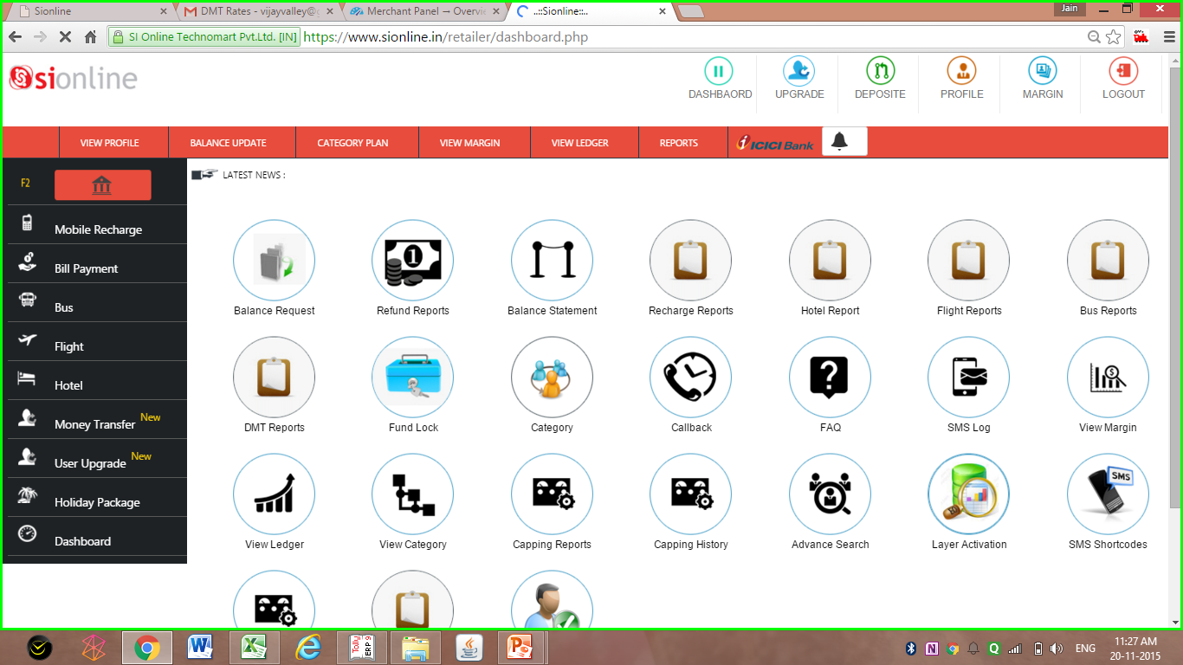
Retailer Login Dash Board
Click Here To Go To Money Transfer

Slide 3
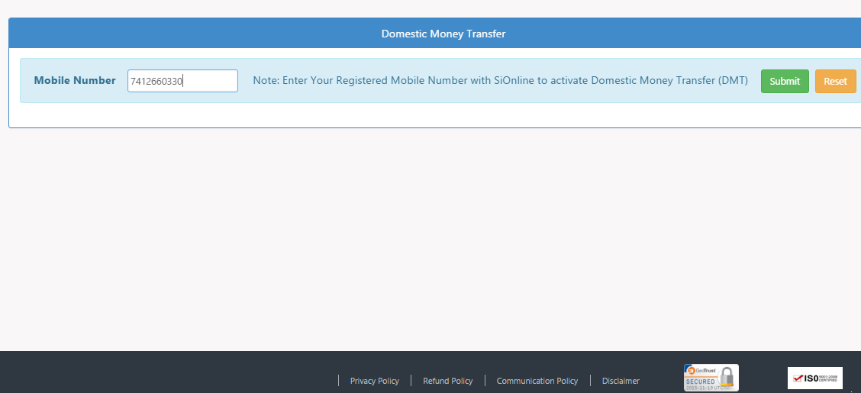
Domestic Money Transfer Activation Page for Retailer
Enter Your Mobile Number Registered With SiOnline To Activate Money Transfer Option in Your Retailer ID
Retailer Can Register up to 5 Different Mobile Number To Activate Money Transfer Services

Slide 4
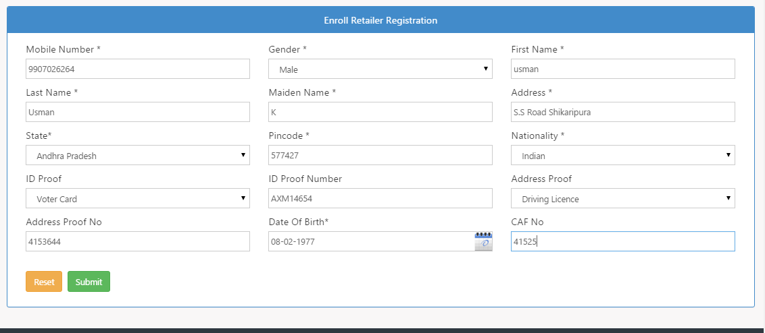
Update Your Retailer Details Page
Retailer’s Detail Will Be Automatically Pulled From Your SiOnline Retailer ID
Biz Name, Address, City, State, ETC.
Address Proof
ID Proof
Date Of Birth
Retailer Need To Update Address Proof, D.O.B. & Your ID Proof

Slide 5
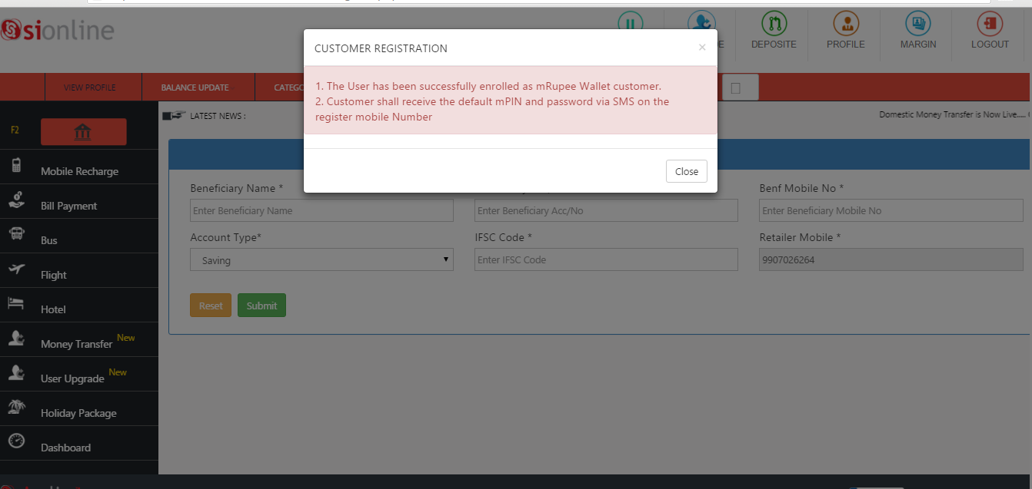
Money Transfer Activated on Retailer ID Activation
Confirmation Page
Confirmation Popup Once Retailer’s Money Transfer Service is Activated

Slide 6
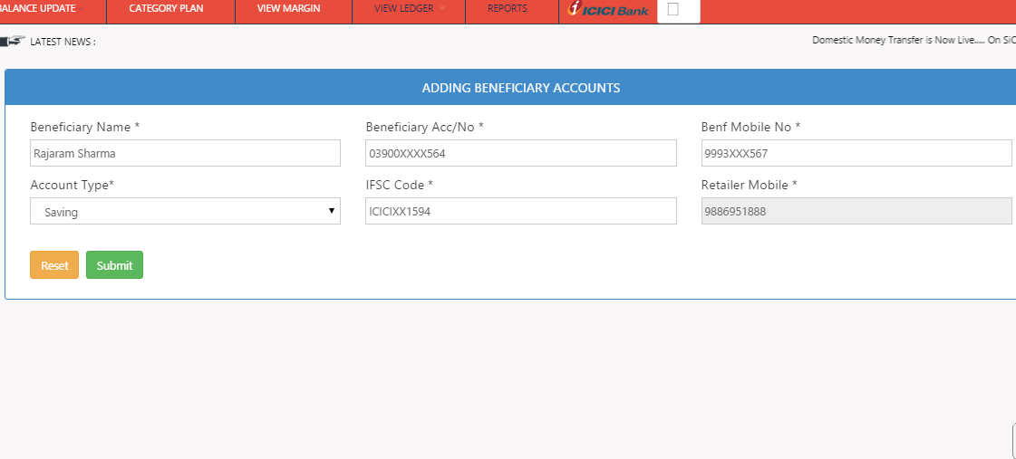
Add Beneficiary Page
Enter Receiver’s Bank IFSC Code
Enter Receiver’s Bank Account Number

Slide 7
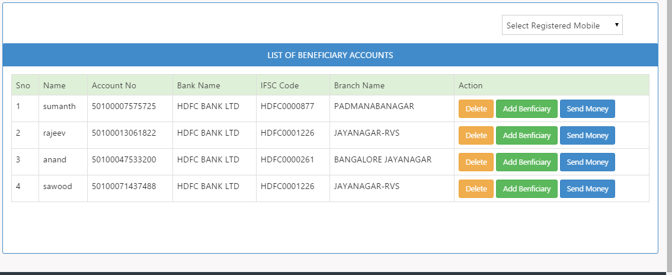
Send Money To Beneficiary Page
Beneficiary IFSC Code
Send Money Button
Beneficiary Account Number
Click on Send Money To Transfer Money to Beneficiary
Account Number With IFSC

Slide 8
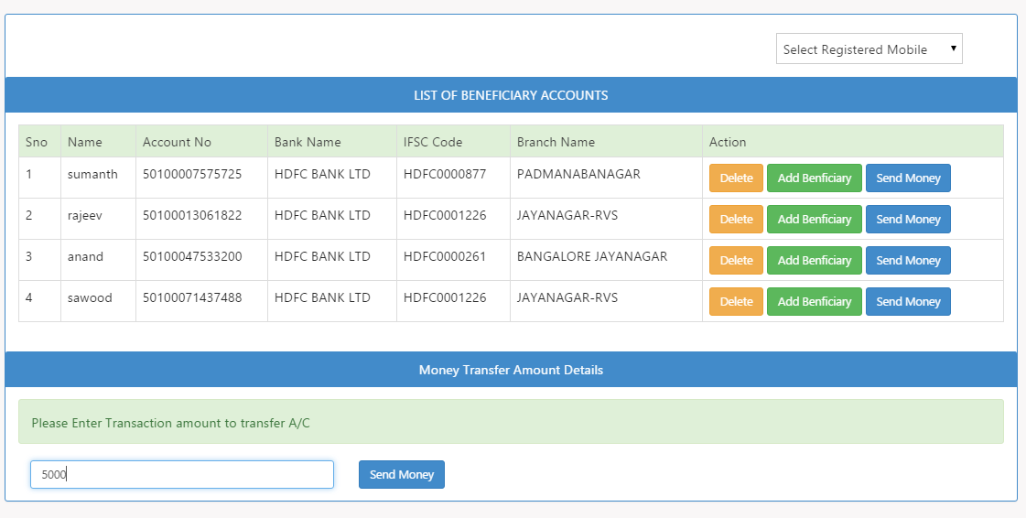
Send Money Page
Enter Amount You Need To Transfer

Slide 9
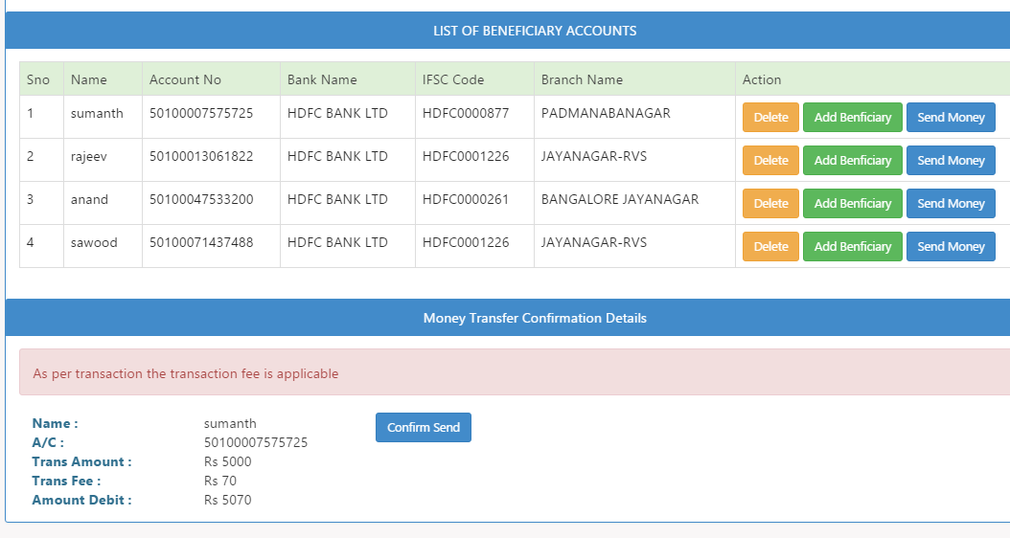
Confirmation Page Before Transferring Money To Benificiary
Money Transfer Confirmation Page With Charges Details
Confirm Send Button To Transfer Money

Slide 10
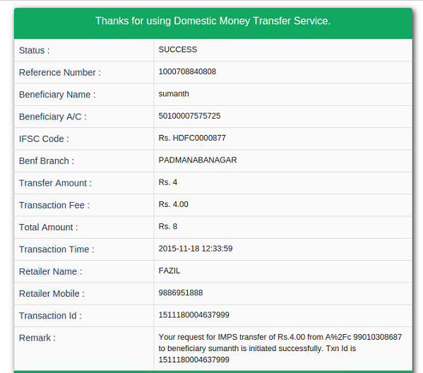
Confirmation Page After Money Transfer is Successful to Beneficiary
Money Transfer Status
& Reference Number
Transaction ID
Remarks With Other Details

Slide 11
FUNCTIONS OF MONEY TRANSFER
Customer Validation – This validates the customer already registered with mRupee or not.
Customer Registration – This is mandatory to register and initiate any Money Transfer transactions.
Adding Beneficiary Accounts – To add beneficiary accounts where the amount needs to be remit.
OTC confirmation – This is mandatory for confirming Beneficiary Accounts and for deleting Beneficiary accounts.
Fetch Beneficiary Accounts – This displays the already added beneficiary accounts in the Customer wallet.
Get Customer Service Charge- This function enables retailer to know the surcharge amount to be charged for the customer for every transaction. (Detailed explanation with technical summary provided on the next page)
Remittance – To transfer money to the registered beneficiary accounts.
Delete Beneficiary Accounts – To delete already added beneficiary accounts in customer wallet.
OTC Confirmation- This is mandatory for confirming Beneficiary Accounts and for deleting Beneficiary accounts.
OTC-Resend- This function is used if the OTC (SMS) not reached to the customer mobile for confirming to add or delete beneficiary.
Re-Initialize Failed Transaction- This function is used to re-initiate the failed remittance transaction. No extra charges are applicable. (Detailed explanation with technical summary provided on the next page)

Slide 12
Business Rules for Domestic Money Transfer*
1- Transaction Limit is 5000 per transaction.
2- Maximum Limit is 10,000 per calendar month.
3- Maximum Limit for Beneficiary account to be added is 8 per customer.
4- Money Transfer is a Non Revocable Action, Make Sure Beneficiary Account Number is Correct.
*Terms & Conditions Apply

Slide 13
Money Transfer Charges & Commission Details
For Customer, Retailer & Distributor
Transaction Amount Slab | Customer Charges Per Transaction | Retailer Commission Per Transaction | Distributor Comm. Per Transaction
Rs.1-5 | 4.00 | 1.00 | 1.00
Rs.6-1500 | 30.00 | 10.00 | 3.00
Rs.1501-2500 | 40.00 | 14.00 | 4.00
Rs.2501-3500 | 50.00 | 17.00 | 5.00
Rs.3501-4500 | 60.00 | 20.00 | 6.00
Rs.4501-5000 | 70.00 | 24.00 | 7.00
Rs.5001-9990* Rs.9901-Above* | 80.00 1.00% Of TXN AMT. | 27.00 0.30%Of TXN AMT. | 9.00 0.10%Of TXN AMT
*Rs.5001+ Slab is Only For Customers Giving KYC

Slide 14
Thank You
Visit us at
www.sionline.co.in
Call Us at
07412-660-330
Email Us at
support@sionline.co.in
Meet Us at
Si Online Technomart Private Limited,
Plot No. 6, Near Rangoli,
Indore- Neemuch Highway.
Ratlam (MP) 457001

